Slide 1
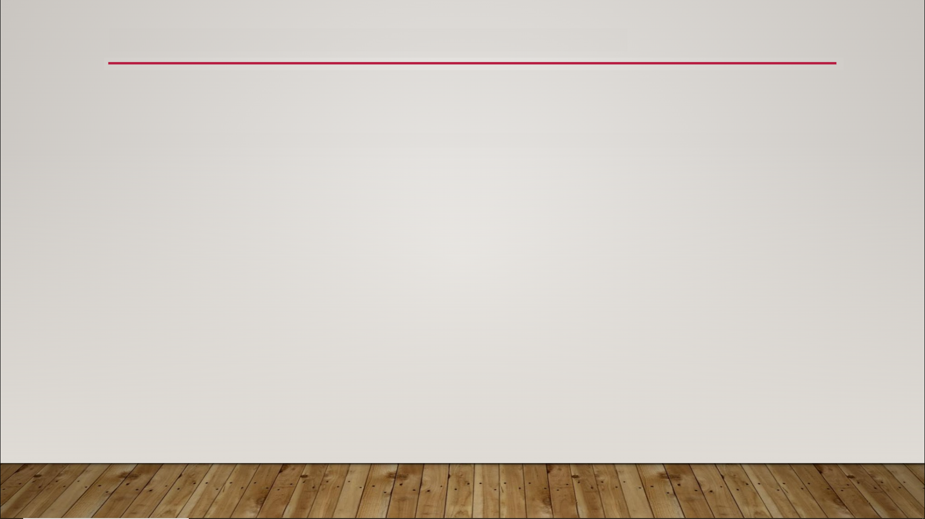
Normal Maps
normal map - memory-efficient way to add small details to a 3D object
allow you to define bumps, cracks, crevices, ridges, etc.
shading of each pixel will be based on the rotation set in the normal map

Slide 2
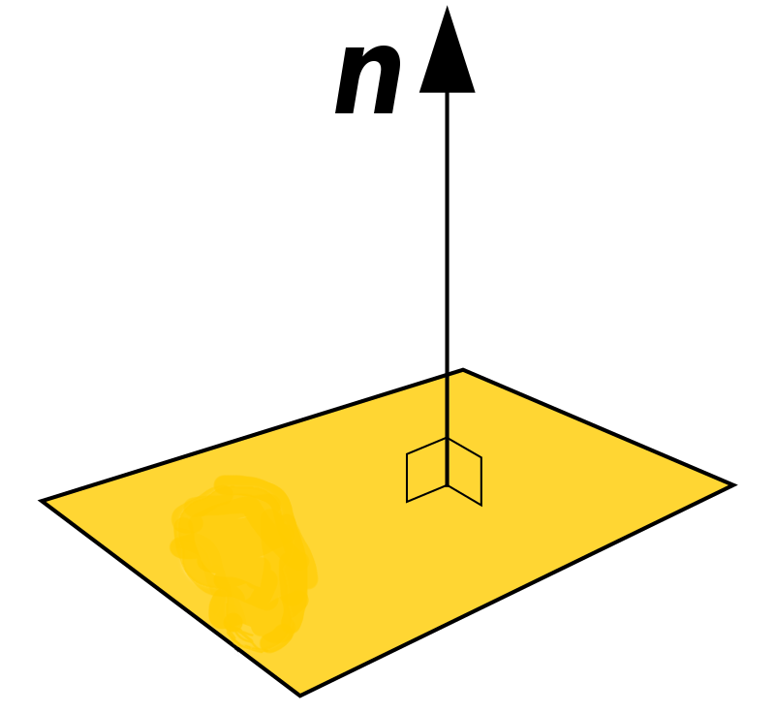
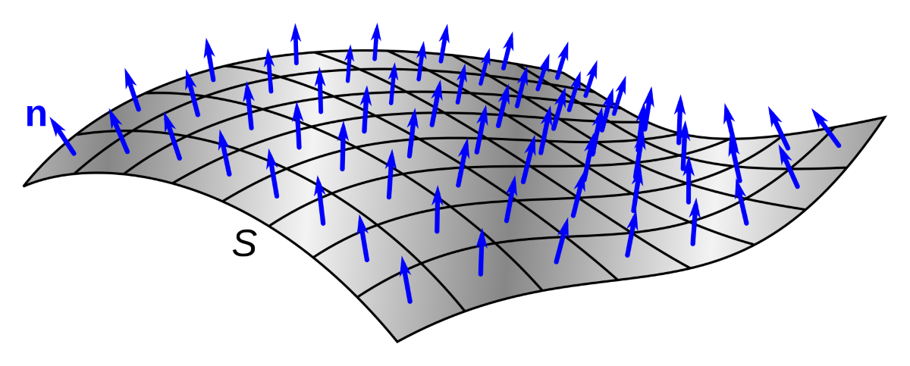
Normal Maps
normal - the vector that is perpendicular to the surface of an object at any given point

Slide 3

Normal Maps

Slide 4
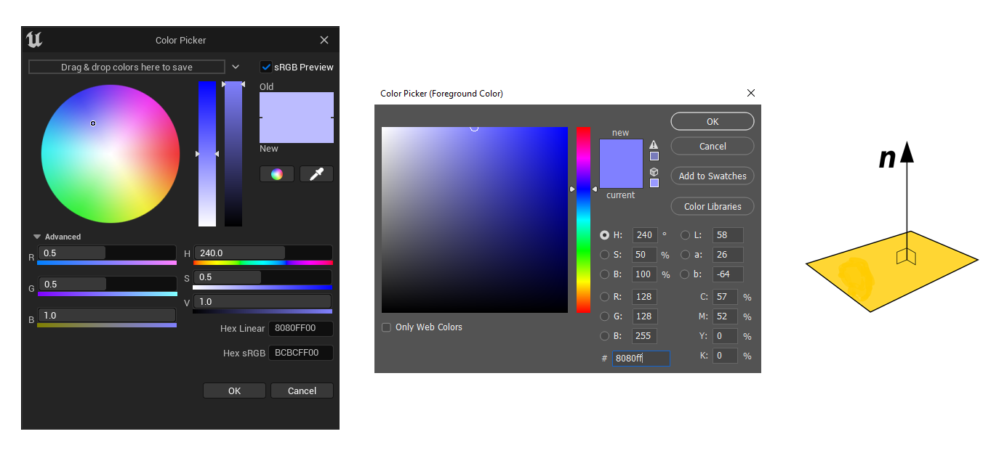
Normal Maps

Slide 5
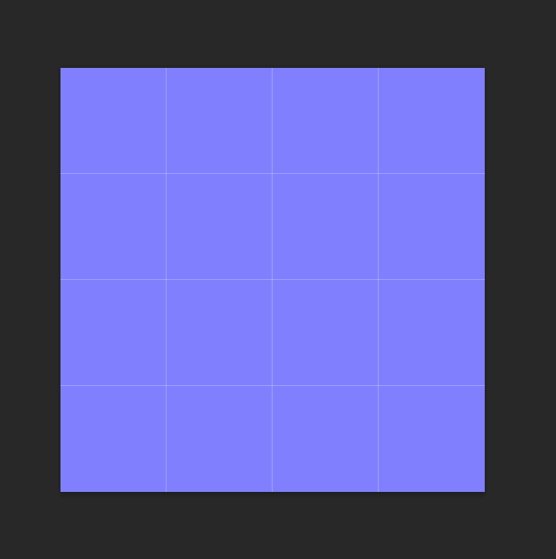
Normal Maps

Slide 6
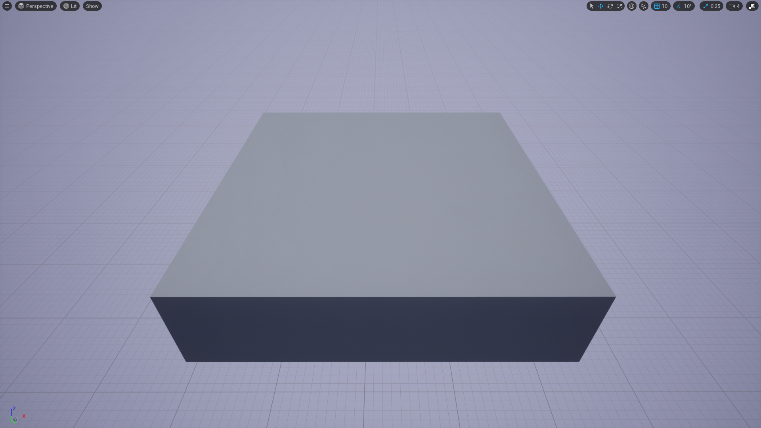
Normal Maps

Slide 7
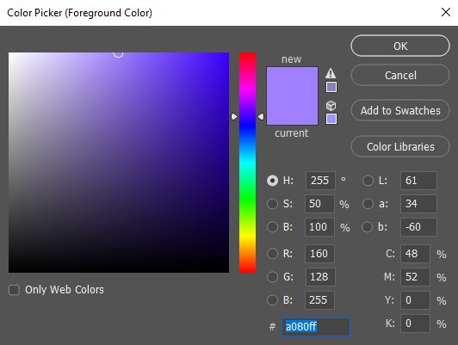
Normal Maps

Slide 8
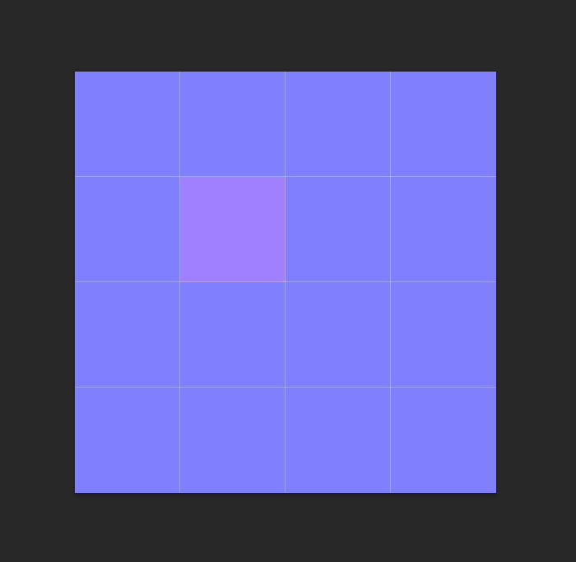
Normal Maps

Slide 9
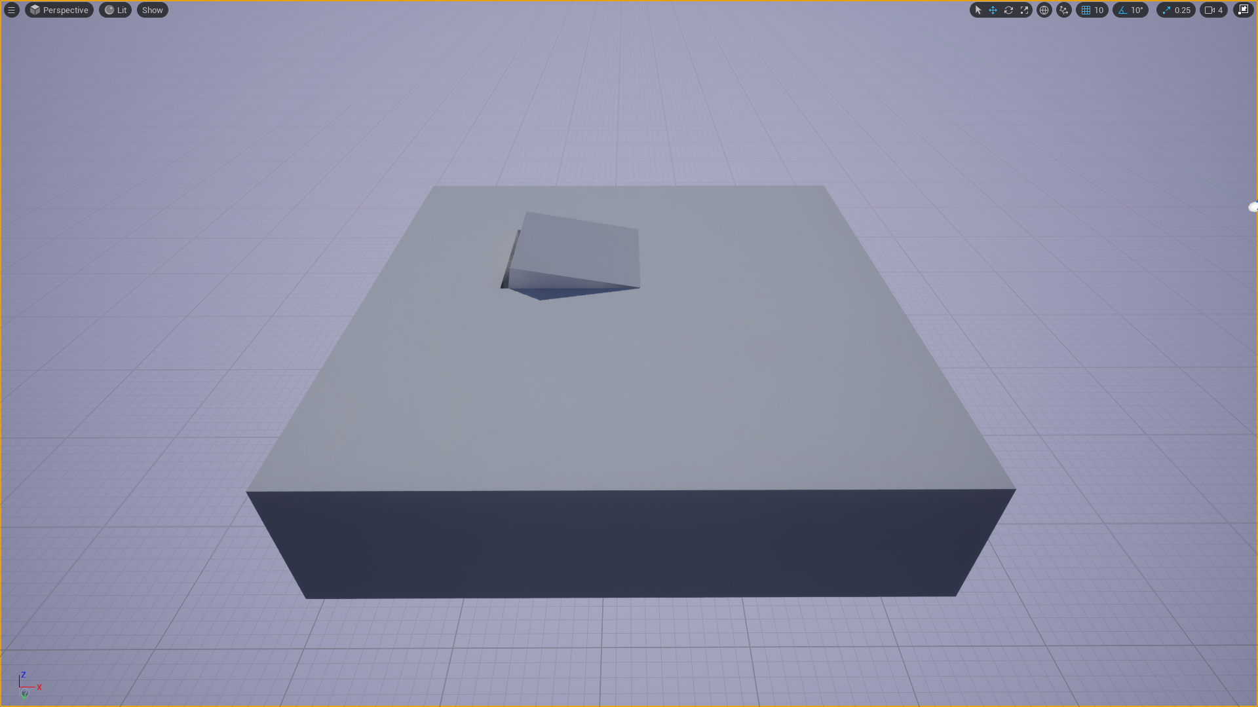
Normal Maps

Slide 10
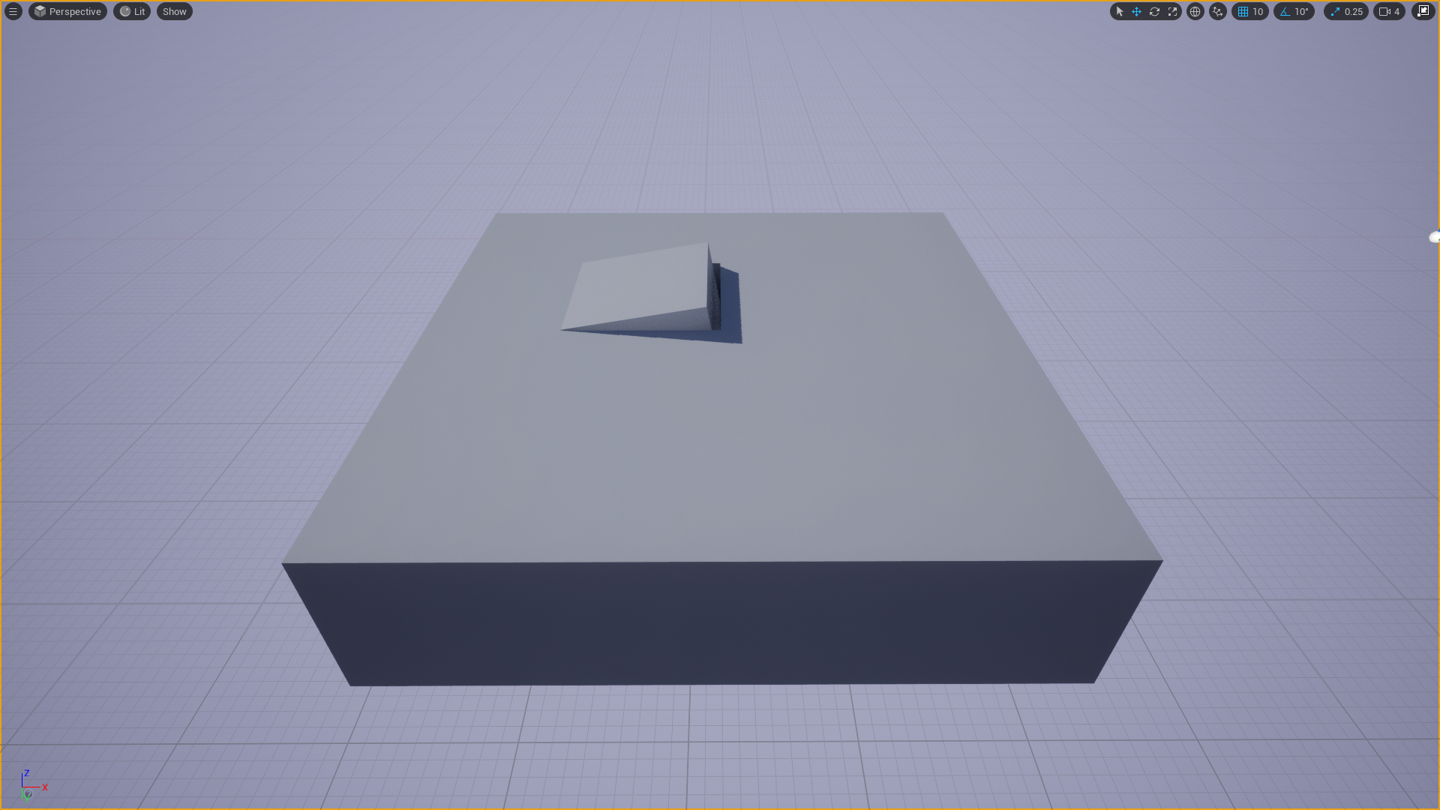
Normal Maps

Slide 11
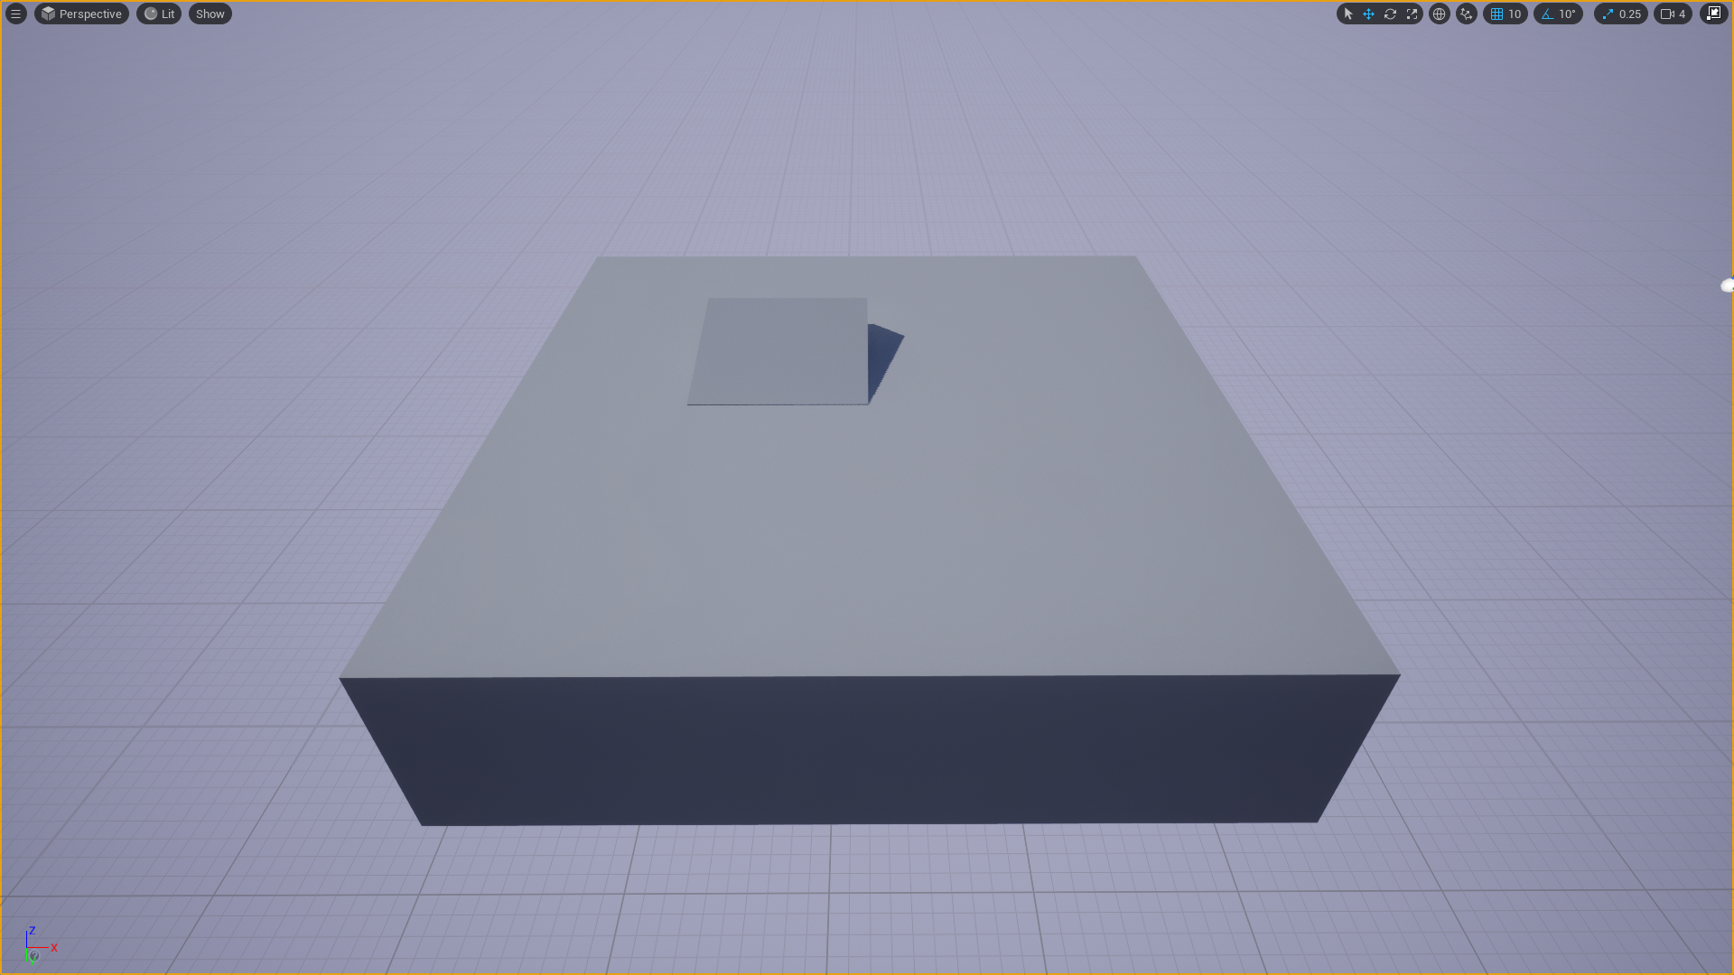
Normal Maps

Slide 12
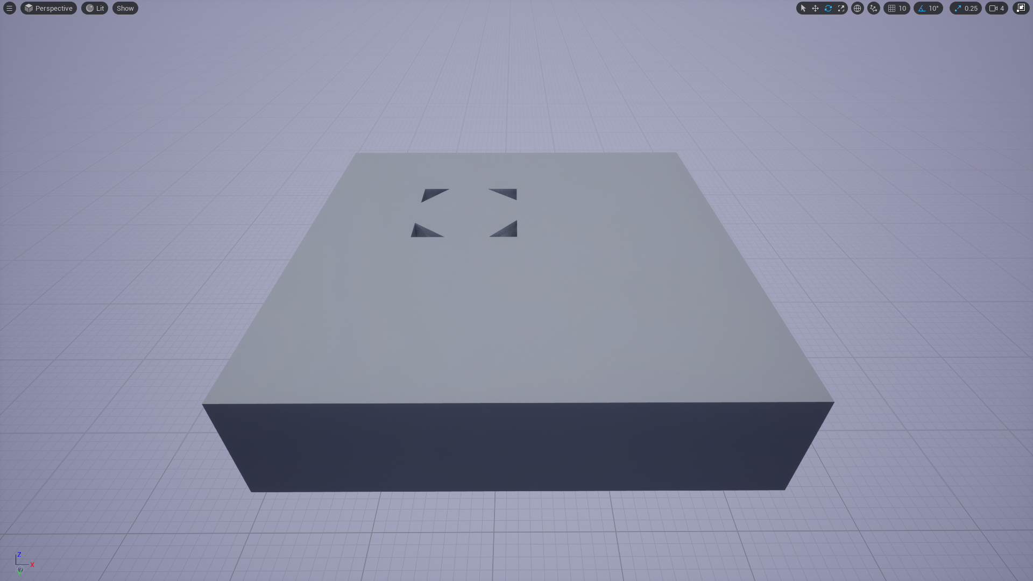
Normal Maps

Slide 13
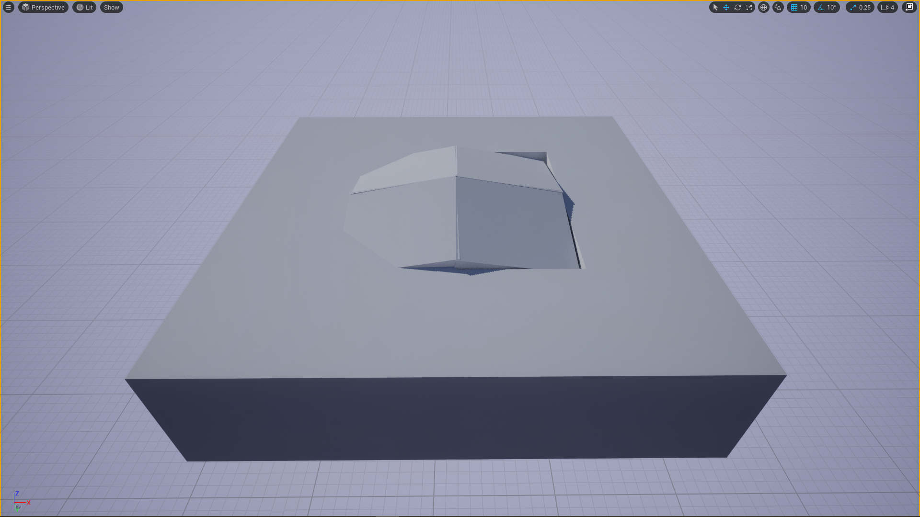
Normal Maps

Slide 14
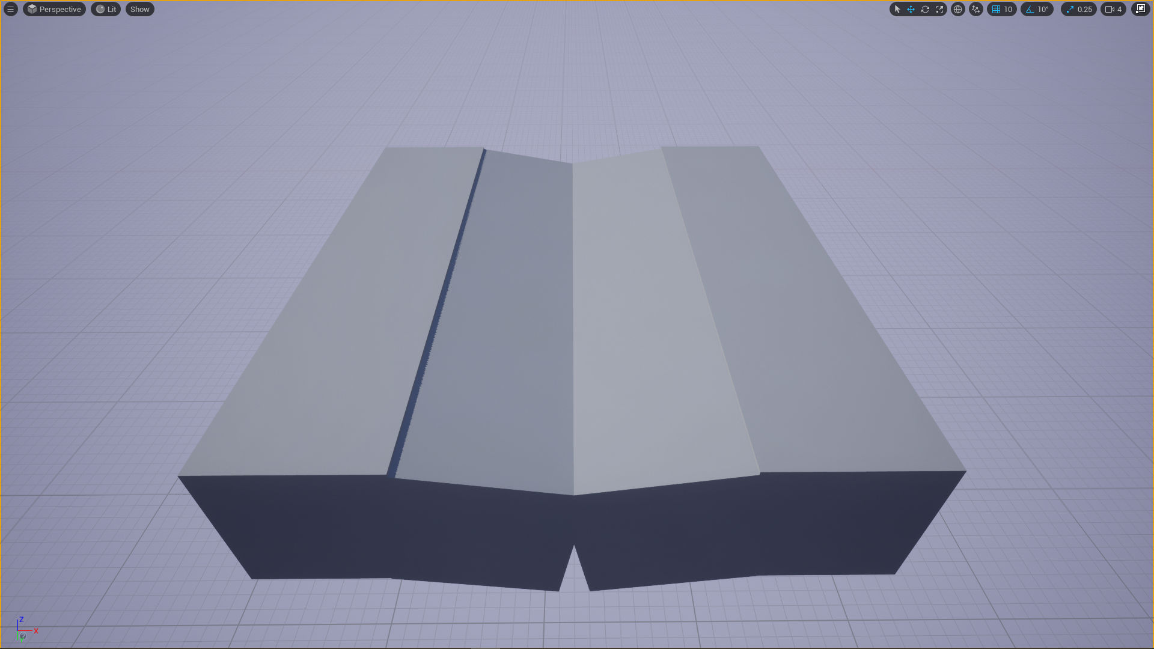
Normal Maps

Slide 15
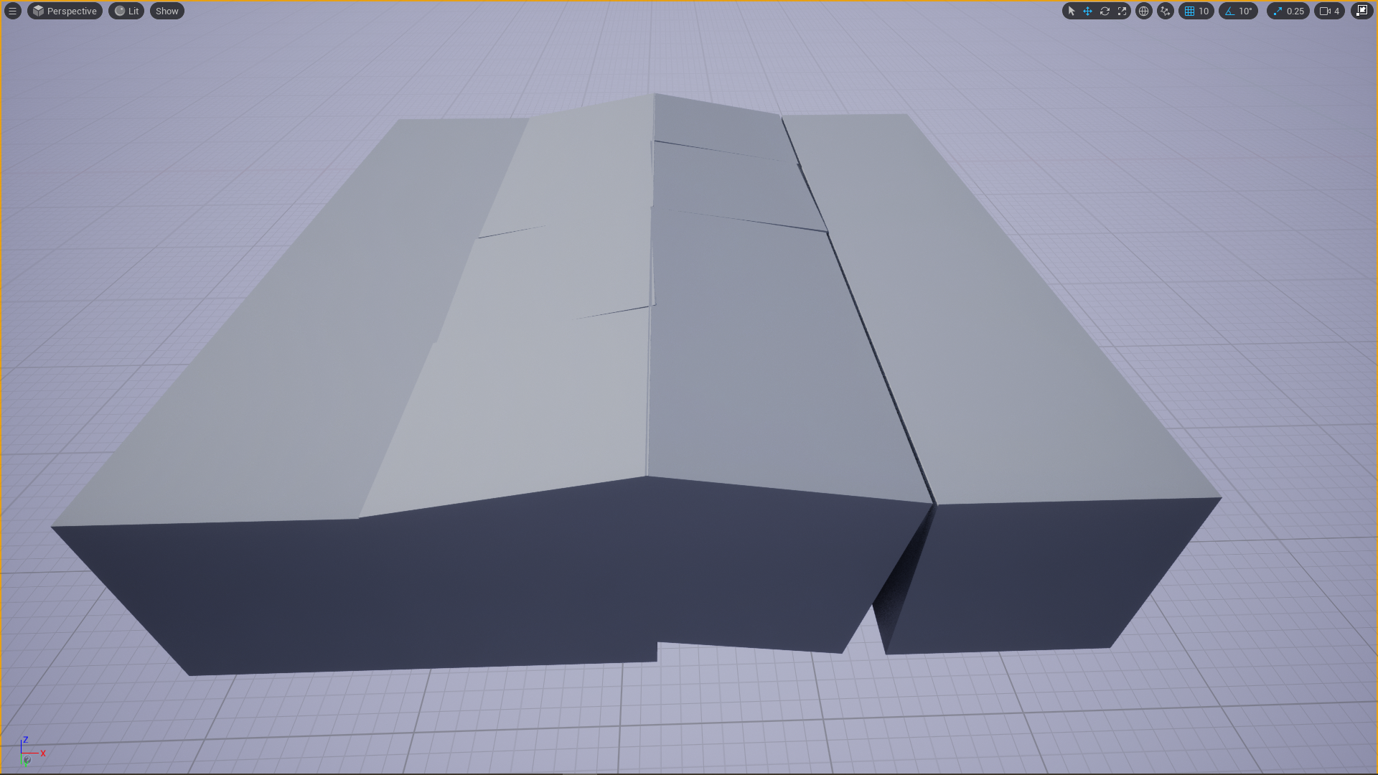
Normal Maps

Slide 16
Normal Maps
color to vector: * 2 - 1
vector to color: ÷ 2 + 0.5
color: (0.5, 0.5, 1)
vector(0, 0, 1)
(0.5,0.5,1)*255=(128,128,255)
(128,128,255)/255=(0.5,0.5,1)
0.5 * 2 - 1 = 0
1 * 2 - 1 = 1

Slide 17
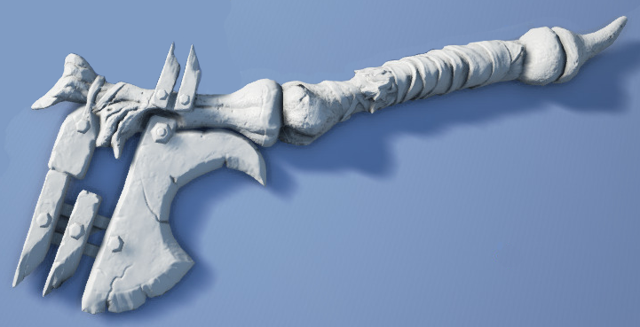
Normal Maps

Slide 18
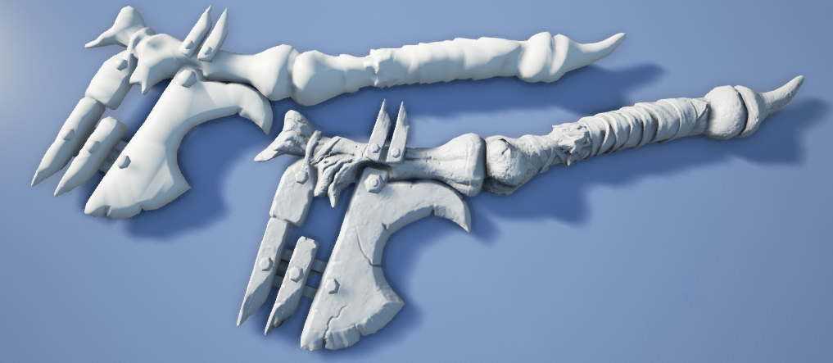
Normal Maps

